Slide 1
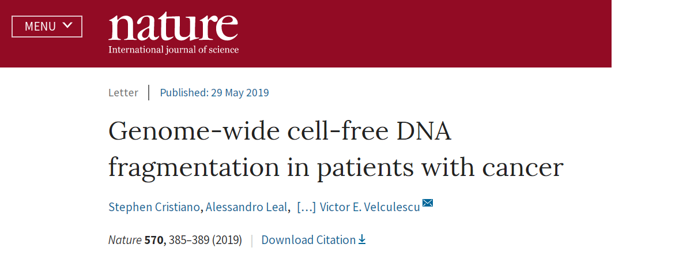
Genome-wide cell-free DNA fragmentation in patients with cancer
Shicheng Guo @ Dr. Steven J Schrodi Lab
Center for Precision Medicine Research
Marshfield Clinic Research Institute
08/17/2019

Slide 2
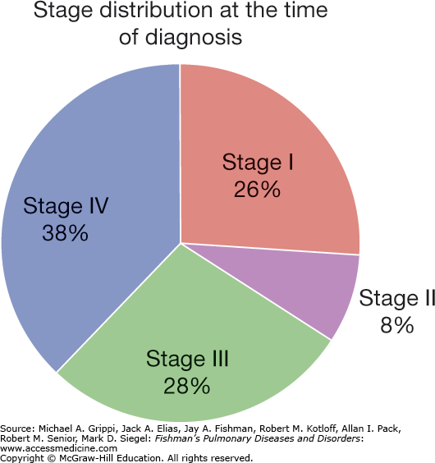
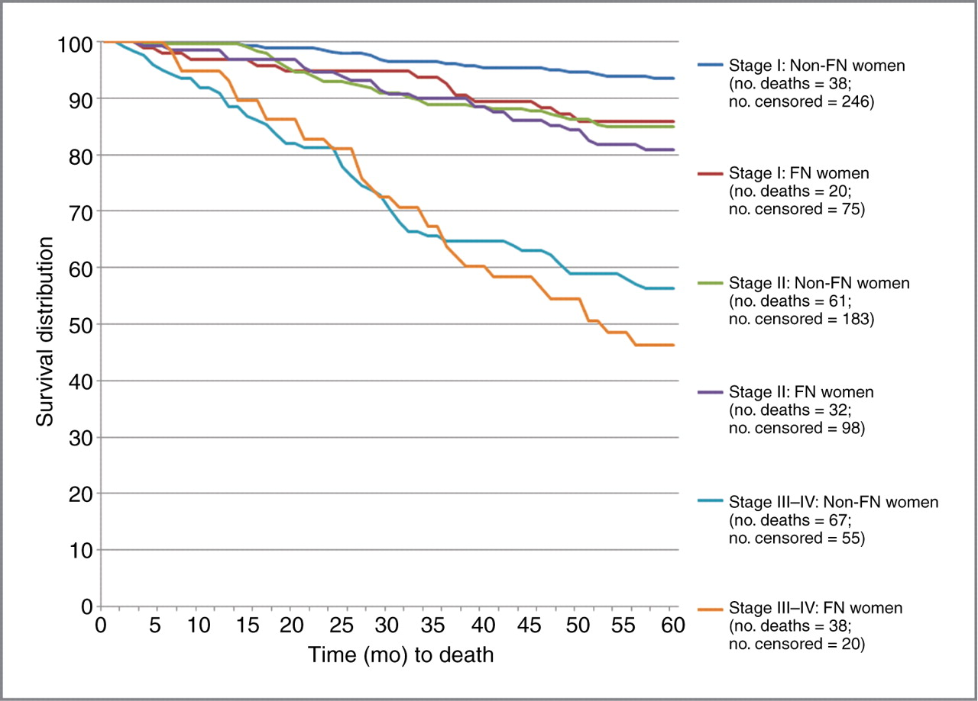
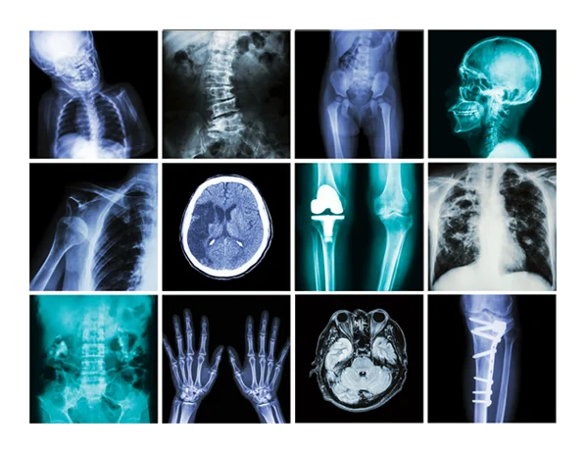
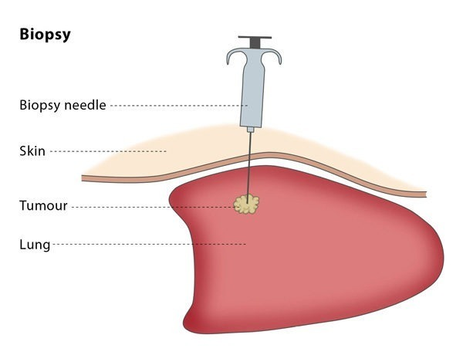
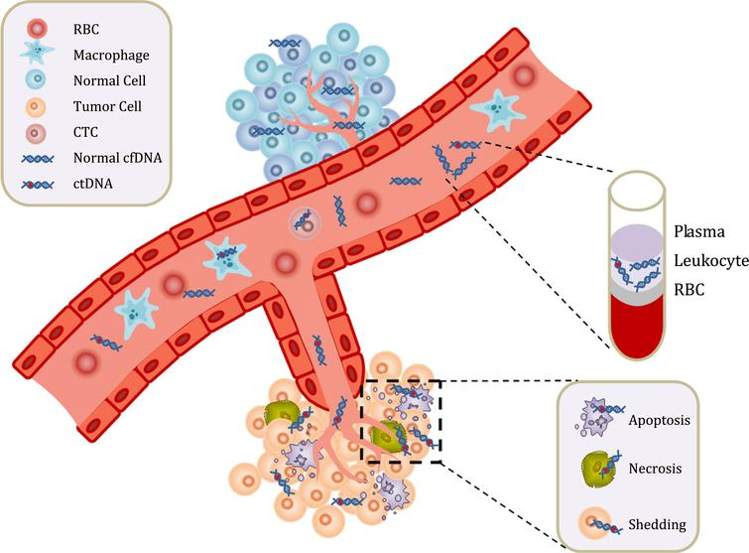
Non-invasive early cancer diagnosis or screening
Low-cost and Convenient
Circulating cell-free DNA

Slide 3
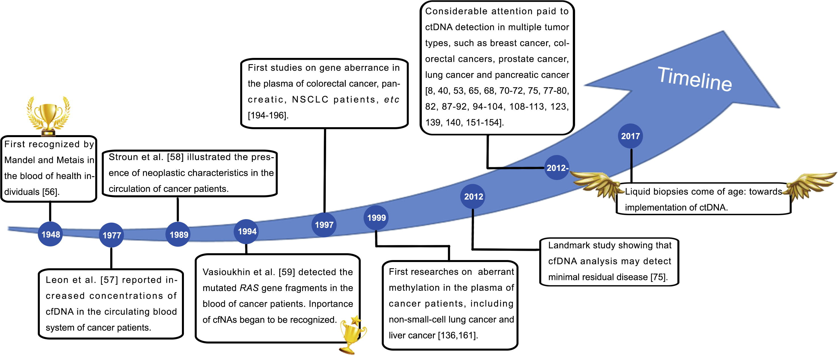
Non-invasive early cancer diagnosis with ct/cfDNA
Genomics, Proteomics & Bioinformatics
Volume 15, Issue 2, April 2017, Pages 59-72

Slide 4
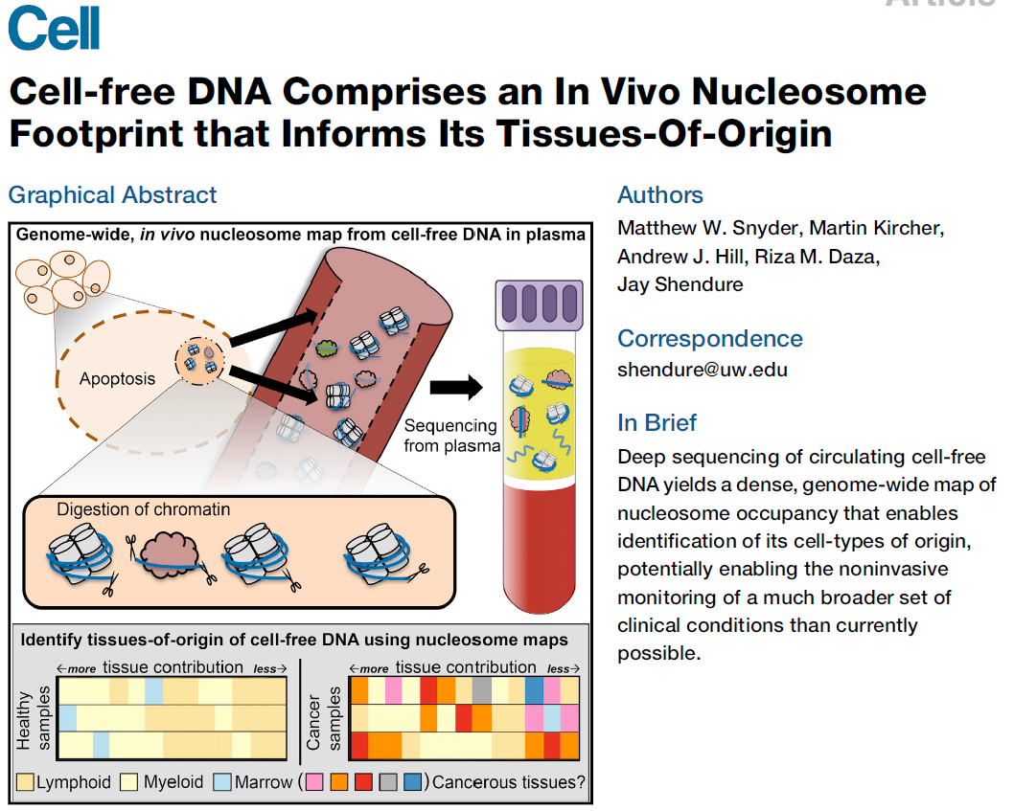
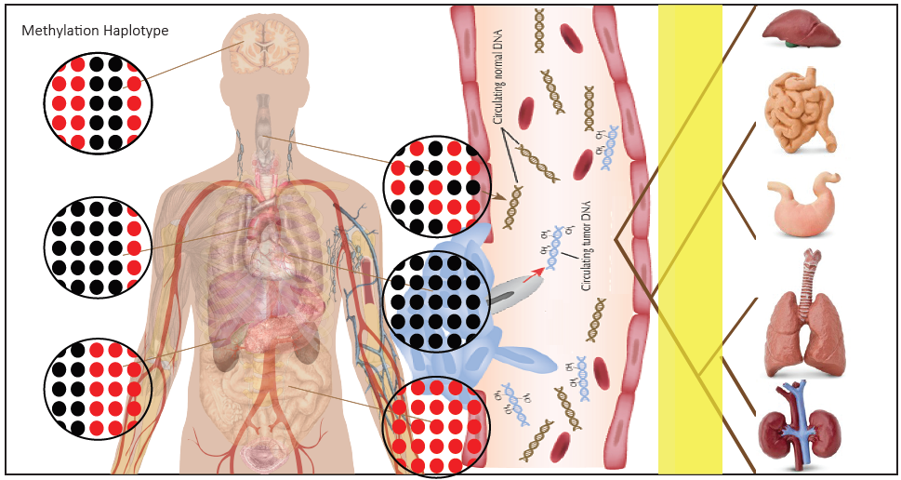
Non-invasive early cancer diagnosis with genetics and epigenetics of cfDNA
Mutation
Methylation
Nucleosomes
cfDNA fragmentation
Low-sensitivity
High depth
High-sensitivity
High-cost
DNA evaluation of fragments for early interception (DELFI)

Slide 5
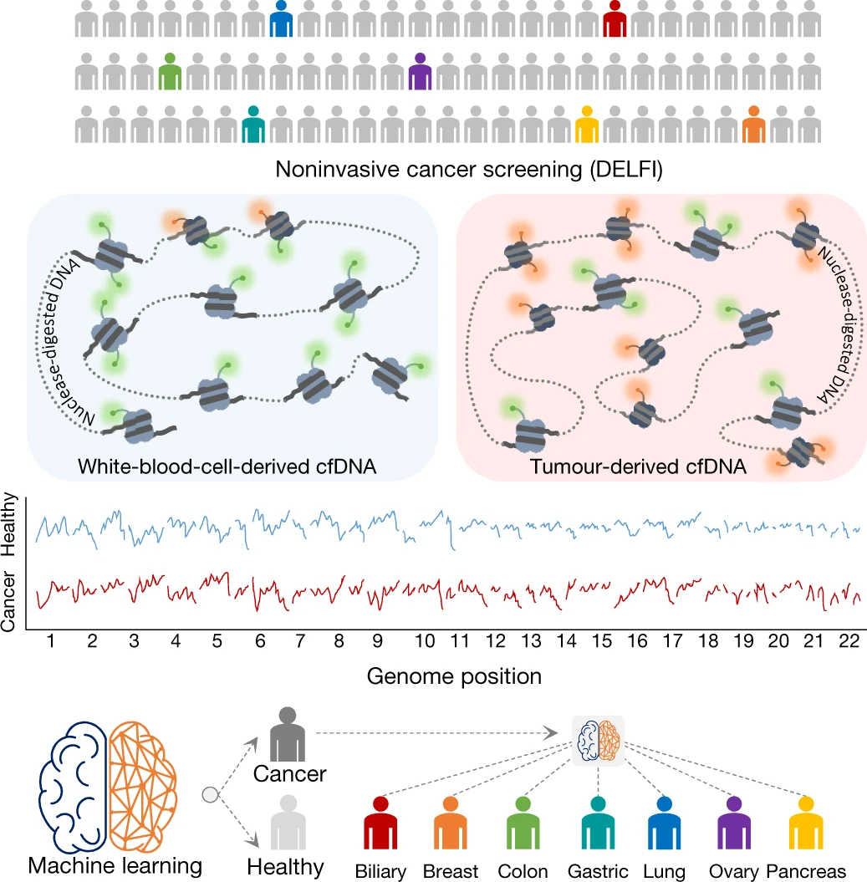
Genome-wide cell-free DNA fragmentation in patients with cancer
Blood is collected from healthy individuals and patients with cancer
cfDNA is extracted from plasma, processed into sequencing libraries, examined by WGS, mapped to the genome
determine cfDNA fragmentation profiles across the genome
Machine learning is used to categorize whether individuals have cancer and identify the tumor tissue of origin
Fig. 1: Schematic of DELFI approach

Slide 6
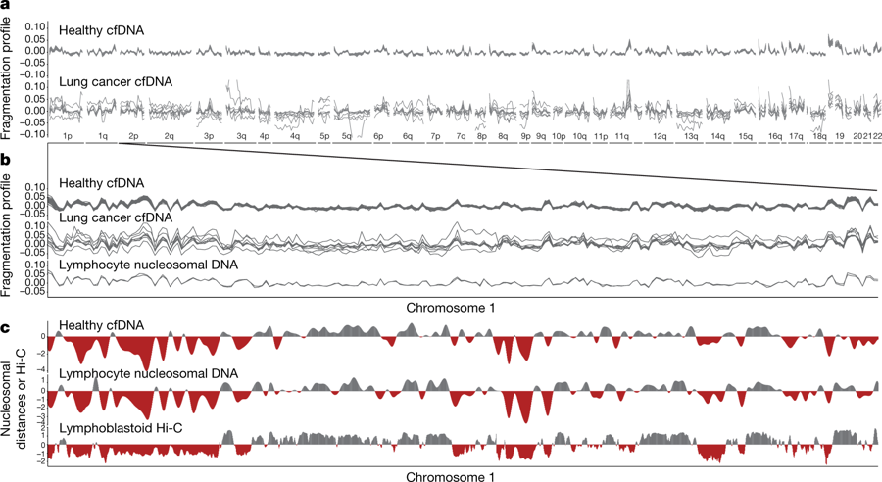
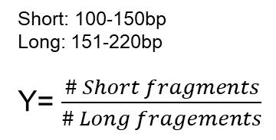
Aberrant cfDNA fragmentation profiles in patients with human cancers
N=30 healthy individuals
Short: 100-150bp
Long: 151-220bp
Y= $\frac{\# Short fragments}{\# Long fragements}$
N=8 patients with lung cancer
Window size=5Mb
Healthy cfDNA patterns were highly correlated to lymphocyte nucleosomal DNA fragmentation profiles and nucleosome distances
Window size=1 Mb
Fragmentation patterns of normal cfDNA are the result of nucleosomal DNA patterns that reflect the chromatin structure of normal blood cells

Slide 7
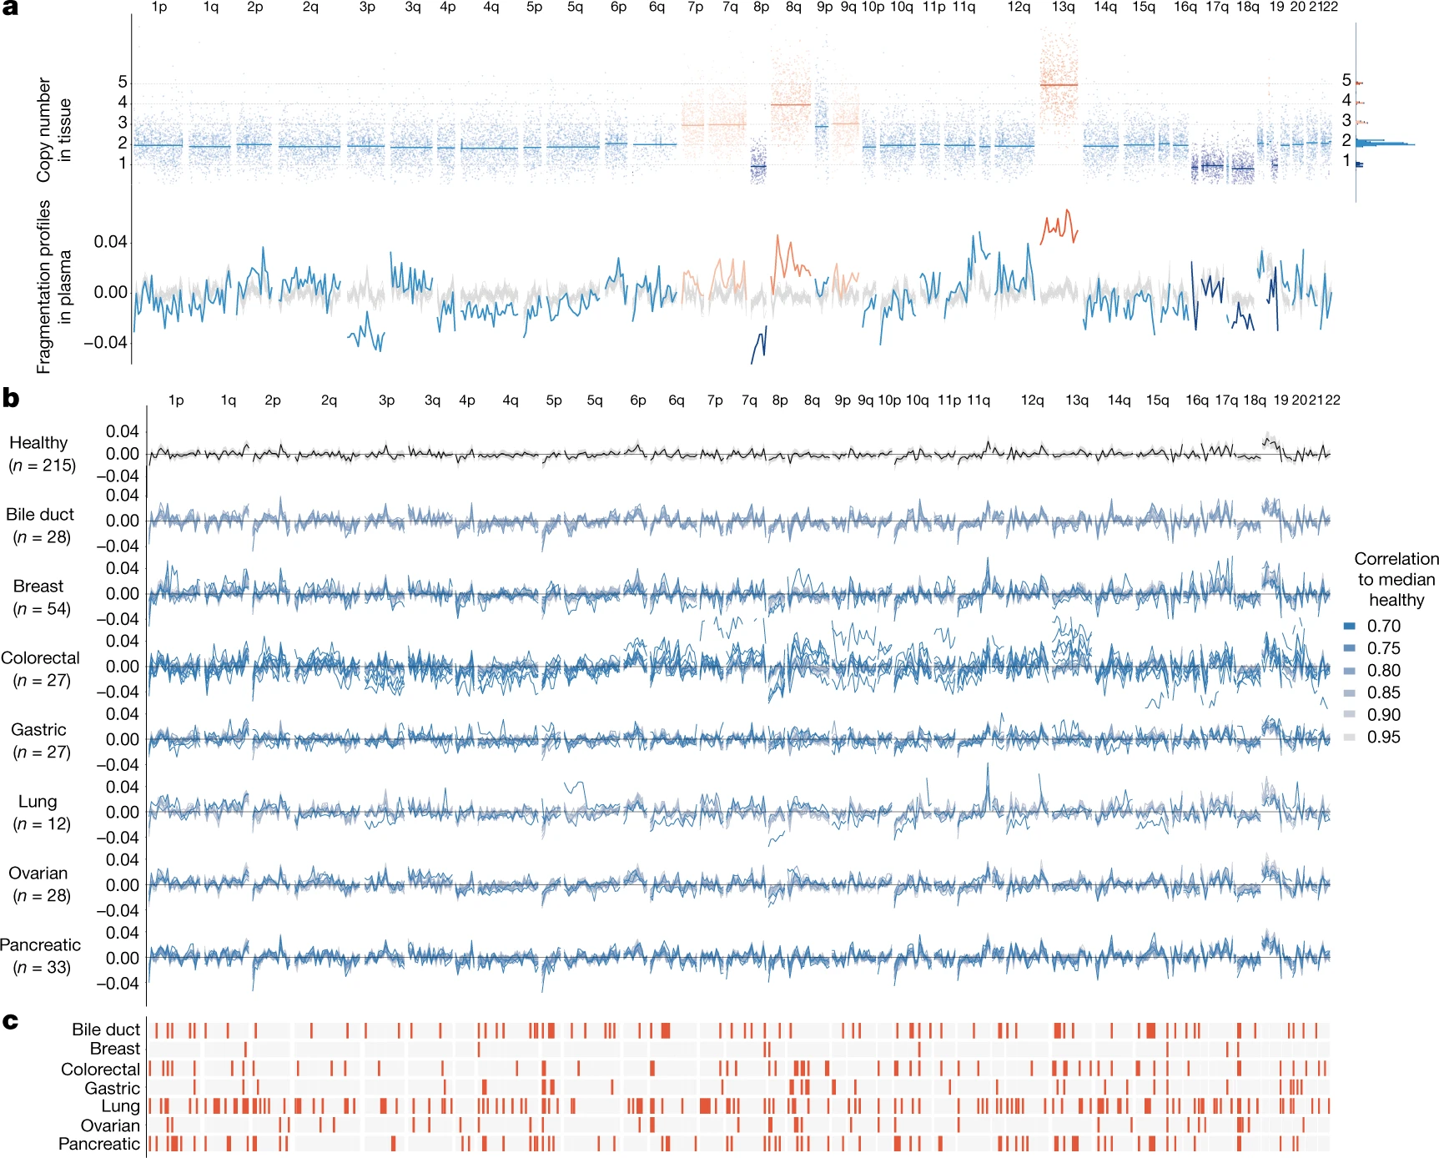
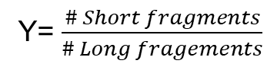
cfDNA fragmentation profiles (low-pass) in healthy individuals and cancer patients
Inferred copy number variations
cfDNA fragmentation profiles
Y= $\frac{\# Short fragments}{\# Long fragements}$
cfDNA fragementation profile indicates CNV aberrant
Healthy individuals had concordant fragmentation profiles whereas patients with cancer had highly variable profiles with decreased correlation to the median healthy profile.
Position-dependent alterations in fragmentation of cfDNA
Cancers are different in cfDNA fragment abnormal

Slide 8
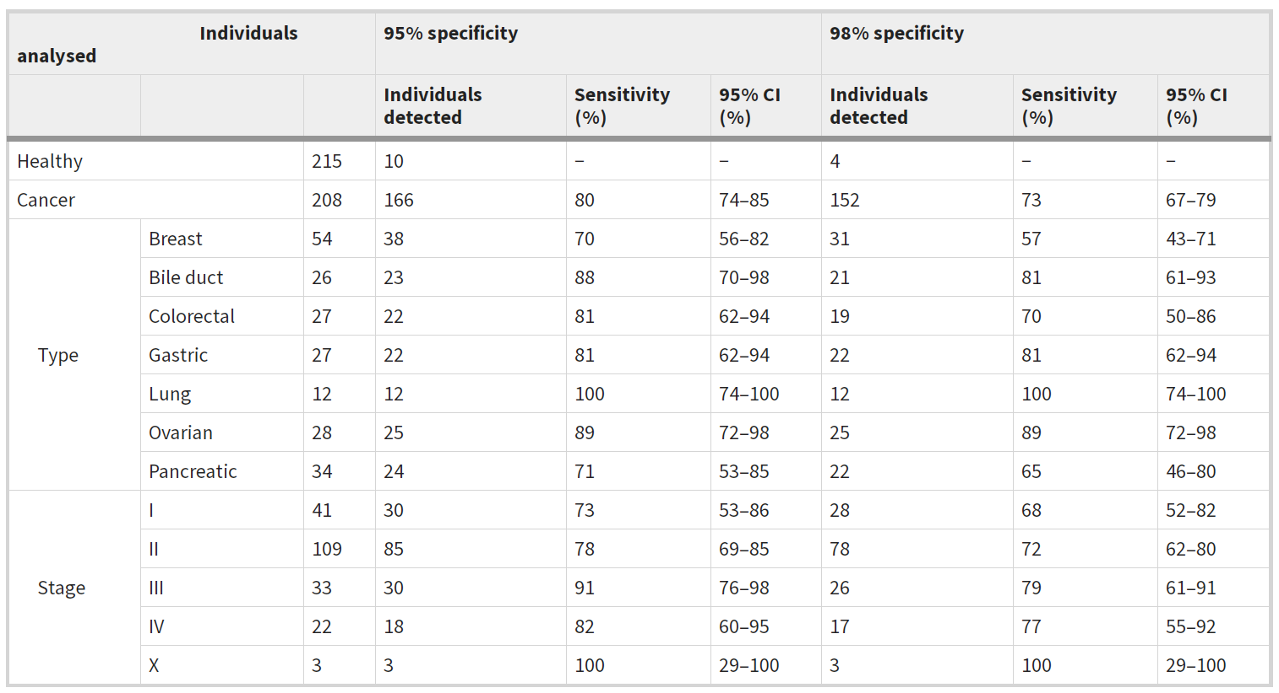
Prediction performance for cancer detection based on cfDNA fragmentation profiles

Slide 9
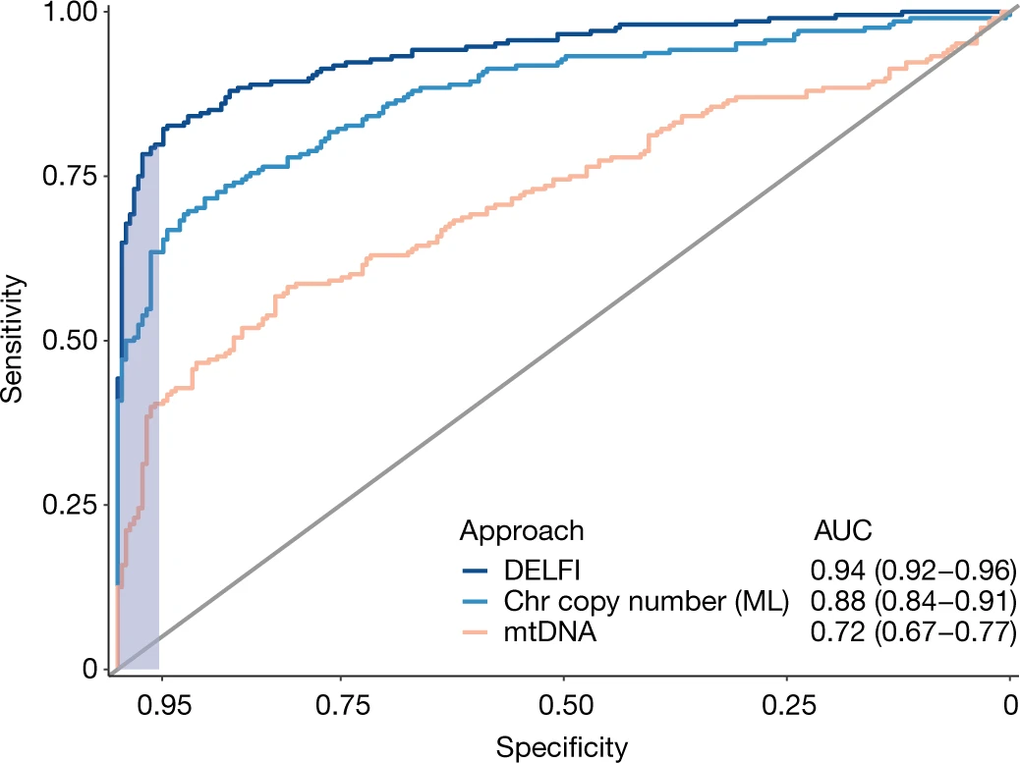
Detection of cancer using DNA fragmentation profiles
Receiver operator characteristics for the detection of cancer using cfDNA fragmentation profiles and other genome-wide features in a machine learning approach (Generalized Boosted Regression) are depicted for a cohort of 215 healthy individuals and 208 patients with cancer
(DELFI, AUC = 0.94), with ≥95% specificity
Chromosomal arm copy number (Chr copy number)
Mitochondrial genome copy number (mtDNA)
95% Specificity
Copy number of Mitochondrial DNA

Slide 10
Summary
cfDNA fragmentation profiles could be took as a useful feature for cancer prediction
Advantage:
Low-cost: 0.5-2x >.. > 0.1x genome-wide DNA sequencing
Non-invasive: cfDNA in 2-10ml plasma
Conflicts
Limitation:
Low compatibility: CNV vs (DNA methylation, Histone modification, Mutation)
Single and traditional machine-learning prediction (Generalized Boosted Regression)
Ratio of coverage of short fragments to long fragments was adjusted by GC contents

Slide 11
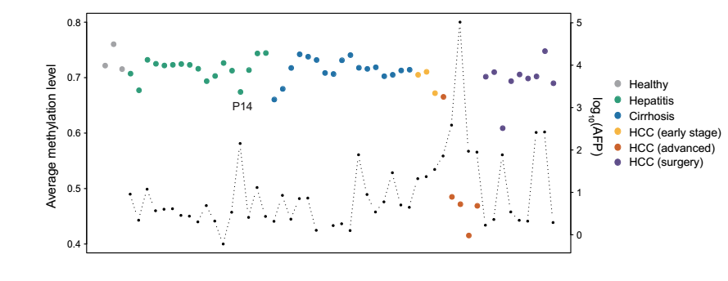
Cell-free DNA methylation levels reveals long-term health status
Long-region average methylation level from low-pass genome-wide DNA methylation sequencing data
Window Size= 2Mbp
How about methylation + cell-free DNA fragmentation profile?
Unpublished Data, Science Advances, Under Review

Slide 12
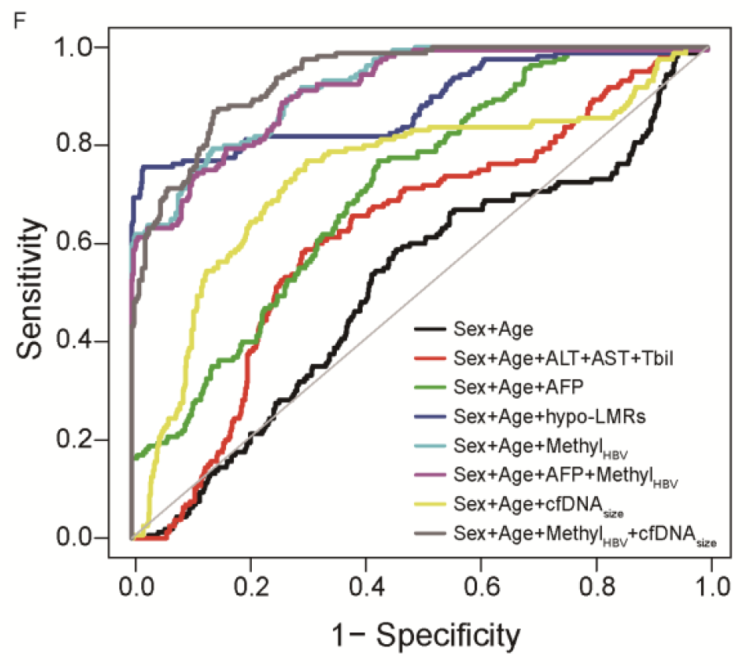
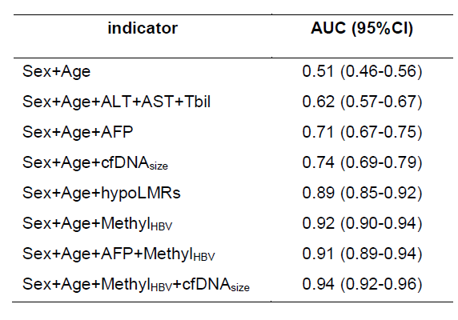
Circulating cell-free DNA based low-pass genome-wide bisulfite sequencing aids non-invasive surveillance to hepatocellular carcinoma
Unpublished Data, Science Advances, Under Review

